Slide 1
Code Art
By: Russell Goldenberg

Slide 2
What is Code Art?
Combine Visual Arts and Computer Science
Explore the creation of artwork using programming as the primary medium.
Create still images, animations, and interactive pieces

Slide 3
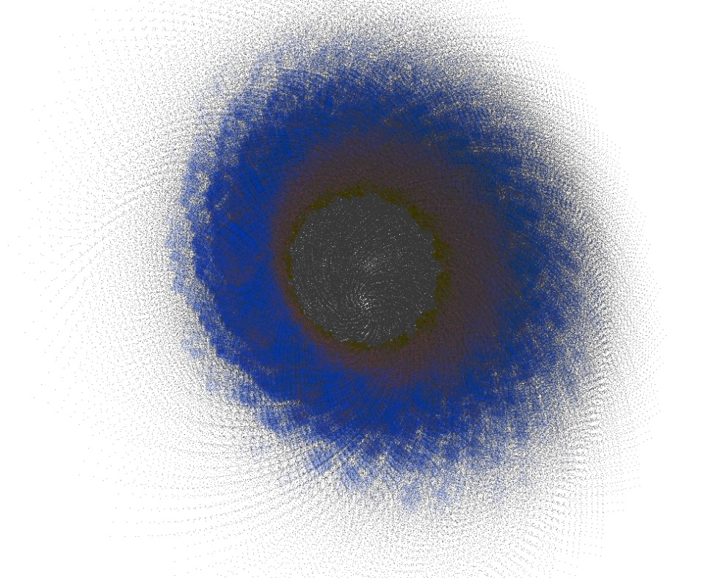
Inspiration for Project
Split between interest in CS and Art
Wanted a balanced fusion of the two topics
Introduced to potential of Processing in AVA 270

Slide 4
Method of Madness
Using the Processing Development Environment.
What is Processing?
Open source language
Developed by Casey Reas and Ben Fry at MIT
Made for programming images, animations, etc.
Why Processing?
Familiarity
Graphics Library
Simplified coding syntax

Slide 5
My Exhibition
Create several finished pieces.
Finalize as prints, animations, and interactive displays.
Prints will be framed and mounted.
Animations will be displayed on LCD screens
Interactive piece will be displayed on a projection screen

Slide 6
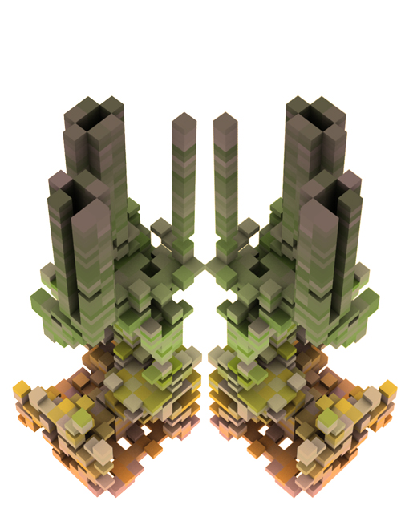
Theme and Concepts
Original idea drastically different than the result
First Term: Fusion of nature and code
Second Term: Sound driven art
Why the change?
Intrigued by new ideas
New direction

Slide 7
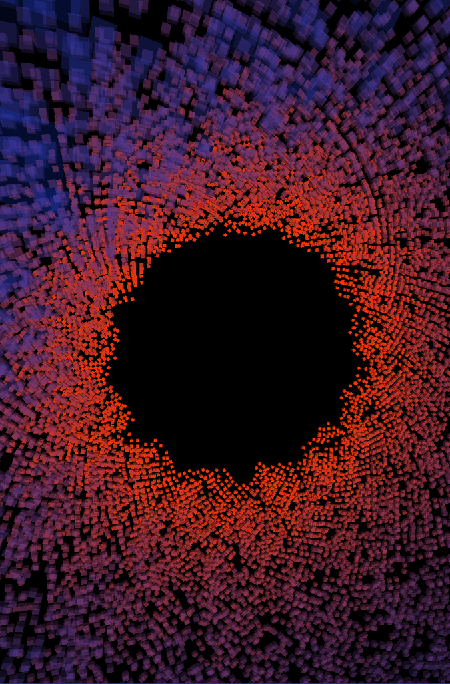
Progress
New direction this term
Setbacks: Working on 5 different pieces
Good news: Exhibition is on May 11th
Current status
4 of the 5 pieces on the verge of completion

Slide 8
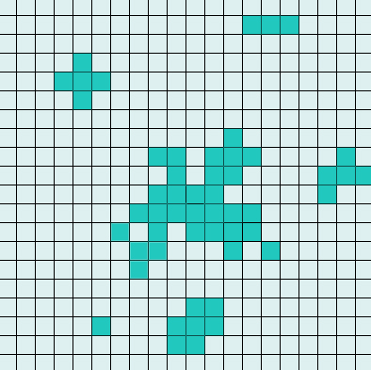
Game of Life
Exercise to familiarize myself with Processing.
Create Conway’s Game of Life.
Develop 3D representation of multiple generations.

Slide 9
Game of Life Images

Slide 10
Game of Life Images

Slide 11
Game of Life Images

Slide 12
Game of Life Images

Slide 13
Music Visualization Freeze Frames

Slide 14
Musical Visualizations
Visual displays of generative art in real time
Sync to the music which determines the parameters
How?
Uses FFT function to retrieve frequencies
These act as the parameters which determine the output
Changes to colors, velocities, method of travel, image, growth, etc.

Slide 15
Music Visualization Freeze Frames

Slide 16
Music Visualization Freeze Frames

Slide 17
Music Visualization Freeze Frames

Slide 18
Sound Drawings
Based on the Musical Visualizations
Creates still drawings based on selected songs
Three separate pieces:
Beethoven’s 7th symphony (4 images for each part)
Neutral Milk Hotel (an entire album creates 1 image)
Devandra Banhart- Little Yellow Spider (1 image)
How it works:
Let the song run to the end and save out the final result

Slide 19
Neutral Milk Hotel Album

Slide 20
Neutral Milk Hotel Album

Slide 21
Beethoven’s 7th

Slide 22
Little Yellow Spider

Slide 23
Jabber
Interactive piece
A portrait that speaks only when a viewer is also speaking as to mock or upstage

Slide 24
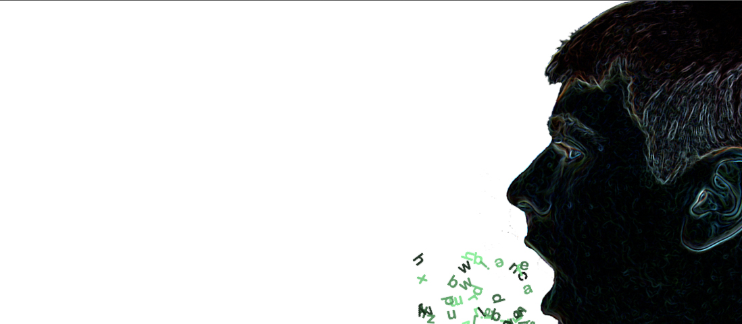
Jabber cont…

Slide 25
Jabber cont…
Why?
Wanted to have some fun and involve the user
Interested to see people’s reactions.
How it works
Uses audio input to determine if someone is speaking (volume level)
This triggers an animation and an audio clip to play

Slide 26
Self Portrait
Wanted to use myself as the subject
Literally composed by code
Uses all the code written for all my projects and replaces the pixels of an image

Slide 28
Canvas
An interactive piece that allows the viewer to create the art
Setup:
A camera will be placed overhead that tracks the movement of the viewer
A projection will display the “canvas” and the real time resulting image

Slide 29
Future Work
Finishing touches on this term’s projects
Next term: Print and frame all the stills
Go back to some previous pieces from first term and finalize them

Slide 30
Questions?

